Slide 1

RATIO & PROPORTION

Slide 2
Ratio & Proportion
Introduction to the topic
Finding actual quantities from given ratios and vice- verse
Merging of ratios from three or more different ratios
Changing of Ratio by Increasing/decreasing values
Coins based Questions
Statement based Questions
Third and Fourth proportions

Slide 3
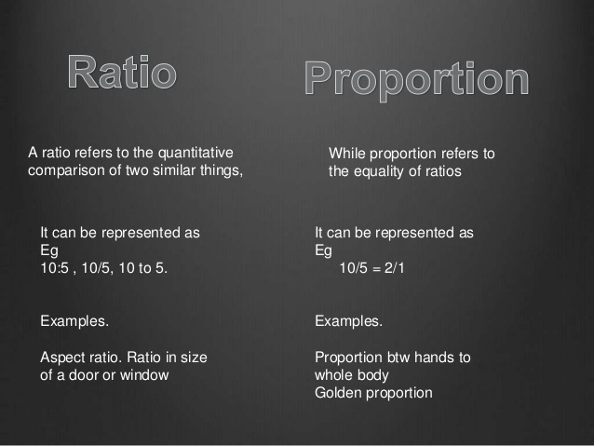
Ratio & Proportion

Slide 4
Merging of Ratio’s
Ratio & Proportion
If A:B=M:N, B:C=P:Q, THEN A:B:C IS
A:B:C= MP:PN:NQ
If A:B=M:N, B:C=P:Q, C:D=R:S,THEN A:B:C:D IS
A:B:C:D=MPR:NPR:NQR:NQS
FOR EXAMPLE,
A:B=2:3
B:C=3:4
C:D=4:5
A:B:C:D=2*3*4:3*3*4:3*4*4:3*4*5
A:B:C:D=24:36:48:60
For example:- let a:b :: 3:4 and b:c :: 5:7 , if we have to find the a:b:c.
So a:b become 15:20 and b:c become 20:28
So a:b:c = 15:20:28.

Slide 5
Ratio & Proportion
Properties of Proportion: (i) a:b = c:d
can be written as a/b = c/d
which implies, a*d = b*c, or, ad = bc
this property helps in solving many questions
(ii) if a:b = b:c, which means this proportions between three numbers is in the form of
‘Continued proportions’, as all three numbers are having a connection.
So, a/b=b/c or,
ac=b.b or,
ac=b²

Slide 6
Ratio & Proportion
1. Two numbers are respectively 20% and 50% more than a third number. The ratio of the two numbers is:
A. 2 : 5 B. 3 : 5 C. 4 : 5 D. 6 : 7
Notes:
2. Option C
Easy (Compulsory)
Explanation:
Let the third number be x.
Then, first number = 120% of x =
120x
=
6x
100
5
Second number = 150% of x =
150x
=
3x
100
2
Ratio of first two numbers =
6x
:
3x
= 12x : 15x = 4 : 5.
5
2

Slide 7
Ratio & Proportion
2. Rs. 68,000 is divided among A, B, and C in the ratio of 1/2 : 1/4 : 5/16. The difference between the greatest part and the smallest part is:
A. Rs. 8000 B. Rs. 32000 C. Rs. 9000 D. Rs. 16000
Notes:
Option D
Easy (Compulsory)

Slide 8
Ratio & Proportion
3. Divide Rs. 390 among 3 persons A, B and C such that 3 times A’s share, 2 times B’s share and 4 times C’s share are all equal. The shares of A, B and C are respectively?
A. Rs. 120, Rs. 180, Rs. 90 B. Rs. 60, Rs. 90, Rs. 45
C. Rs. 240, Rs. 157, Rs. 90 D. None of these
Notes:
Option A
Moderate (Compulsory) 3A = 2B = 4C. Also A + B + C = 390. ⇒ (4 + 6 + 3)A = 390 × 4 ⇒
A = 120, ∴ B = 180 and C = 90

Slide 9
Ratio & Proportion
4. The number of oranges in three baskets are in the ratio of 3 : 4 : 5. In which ratio the no. of oranges in first two baskets must be increased so that the new ratio becomes 5 : 4 : 3?
A. 1:3 B. 2:1 C. 3:4 D. 2:3
Notes:
Answer: B. 2:1 Moderate (Compulsory) Explanation: Let, B1 : B2 : B3 = 3x : 4x : 5x
again B1 : B2 : B3 = 5y : 4y : 3y
Since there is increase in no.of oranges in first two baskets only, it means the no. of oranges remains constant in the third basket
Therefore, 5x = 3y
Hence 3x : 4x : 5x => 9y5:12y5:15y59y5:12y5:15y5 = 9y:12y:15y
and 5y : 4y : 3y => 25x : 20x : 15x
Therfore, increment in first basket = 16
Increment in second basket = 8
Thus, required ratio = 16/8 = 2:1

Slide 10
Ratio & Proportion
5. The ratio of two numbers is 9 : 5. If 9 is added to the greater number and 5 is subtracted from the smaller number, the greater number becomes thrice the smaller one. Find the numbers.
A. 72, 40 B. 18, 10 C. 36, 20 D. None of these
Notes:
Option C
Moderate (Compulsory) Present ratio = 9 : 5. ∴actual values are 9x and 5x. Hence 9x + 9 : 5x – 5 = 3 : 1 ⇒ x = 4. ∴ numbers are 9(4) = 36 and 5(4) = 20.

Slide 11
Ratio & Proportion
6. 300 coins consists of 1 rupee, 50 paise and 25 paise coins, their values being in the ratio of 10 : 4 : 3. Find the number of coins of each type?
A. 100, 80, 120 B. 80, 90, 100
C. 100, 100, 80 D. 60, 80, 100
Notes:
Option A
Moderate (Compulsory) Value of rupee coins = 10 i.e. 10 coins. Value of 50 p coins = 4 i.e. 8 coins. Value of 25 p coins = Rs. 3 i.e. 12 coins. ∴ Ratio of coins = 10 : 8 : 12 ⇒ 5 : 4 : 6. ∴ Number of rupee coins = 5/15 × 300 = 100. Number of 50 P coins = 4/15 × 300 = 80 and Number of 25 P coins = 6/15 × 300 = 120

Slide 12
Ratio & Proportion
7. The ratio of number of 2 rupees coins and 5 rupees coins that Maria has is 6:11. If the number of 5 rupees coins is halved, then she will have an amount of Rs. 790. How many 2 rupees coins does Maria have?
A. 84 B. 108 C. 120 D. 220
Notes:
Option C
Moderate (Compulsory)

Slide 13
Ratio & Proportion
8. A dog takes 3 leaps for every 5 leaps of a hare. If one leap of the dog is equal to 3 leaps of the hare, the ratio of the speed of the dog to that of the hare is:
A. 9:5 B. 2:3 C. 4:7 D. 5:6
Notes:
Answer: A. 9:5 Moderate (Compulsory) Explanation: Dog : Hare = (3*3) leaps of hare : 5 leaps of hare = 9 : 5.

Slide 14
Ratio & Proportion
9. The ratio of the first and second-class fares between the two stations is 6 : 4 and the number of passengers travelling by first and second-class is 1 : 30. If Rs. 2100 is collected as fare, what is the amount collected from first class passengers?
A. Rs.250 B. Rs. 200 C. Rs. 150 D. Rs. 100
Notes:
Option D
Expert (Optional) Ratio of the amounts collected from 1st and 2nd class = (6 × 1): (4 × 30) = 1 : 20. ∴ Amount collected from 1st class passengers = × 2100 = 100.

Slide 15
Ratio & Proportion
10. The concentration of petrol in three different mixtures (petrol and kerosene) is 1/2 , 3/5 and 4/5 respectively. If 2 litres, 3 litres and 1 litre are taken from these three different vessels and mixed. what is the ratio of petrol and kerosene in the new mixture?
A. 4:5 B. 3:2 C. 3:5 D. 2:3
Notes:
Answer: B. 3:2 Expert (Optional) Explanation: Concentration of petrol in A B C
1/2 3/5 4/5
Quantity of petrol taken from A = 1 litre out of 2 litre
Quantity of petrol taken from B = 1.8 litre out of 3 litre
Quantity of petrol taken from C = 0.8 litre out of 1 litre
Therefore, total petrol taken out from A, B and C = 1+1.8+0.8 =3.6 litres
So, the quantity of kerosen =(2+3+1) - 3.6 =2.4 litre
Thus, the ratio of petrol to kerosene = 3.6/2.4 = 3/2

Slide 16
Ratio & Proportion
11. If there are two sections, of class 10th in a school, section A says if some of the students of section B will join us then ratio of students of class A to that of class B becomes 4 : 9, but if some of our classmates goes to section B then its ratio become 3 : 7, if it is known that according to government rule one school can take maximum 200 students in a class (including all sections) then total number of students in 10th class?
A. 150 B. 160 C. 130 D. 180
Notes:
Option C
Expert (Compulsory)

Slide 17
Ratio & Proportion
12. The monthly income of A and B are in the ratio of 3: 4 respectively and the monthly saving of A, B, and C are in the ratio of 4: 5: 6 respectively. The monthly expenditure of A is Rs. 2500 less than that of C and the monthly expenditures of B is Rs. 1000 more than that of A. Every month, C spends Rs. 5000 then how much money does he save?
A. Rs. 4500 B. Rs. 3000 C. Rs. 3500 D. Rs. 2500
Notes:
Option B
Expert (Compulsory)

Slide 18
Ratio & Proportion
13. The mean proportional between (3+√2) and (12-√32) is
A. √7 B. 2√7 C. 6 D. √5
Notes:
Option B
Easy (Compulsory)

Slide 19
Ratio & Proportion
14. The fourth proportional to 75, 192 and 200 is equal to fourth proportional to 90, 384 and Q. Find the value of Q.
A. 100 B. 108 C. 120 D. 126
Notes:
Option C
Easy (Compulsory)

Slide 20
Any Doubts???

